Slide 1
Intro to Hackathons
2023 Hyland Hackathon

Slide 2

Agenda
Rundown
Project Work
General Advice
Inspiration
Notes:
We’re going to start with a rundown of some important information. Then we’ll

Slide 3
tinyurl.com/ hackhyland2023
First Stop: Hackathon Website
Notes:
First, you'll want to go to this website: tinyurl dot com slash hack hyland 2023. this page has a ton of great resources, including this PowerPoint presentation! Be sure to check it out.

Slide 4
WHY ARE YOU HERE?
To Learn New Concepts
To Start Developing a Project
To Win the Competition
Notes:
Now let’s get into it. Why did you sign up for the hackathon? This can help guide the introductory discussion. Some of them may want to build something, some of them may want to learn about software development, some of them might want to meet new people, some of them may have been forced into it by parents or teachers… whatever their reasons, they all ended up here. Also ask them why they might be at the workshop specifically.

Slide 5
What is a Hackathon?
Notes:
Now let's get into it. What is a hackathon? // Well, it's a HACKing MarATHON. // The goal is to build a complete software project within the allotted time. // Teams and ideas can be established ahead of time, OR during the event. // However, all code for the project must be written during the event. Also note that "Hacking" in this instance does not mean breaking into anything - it's all about building. ///

Slide 6
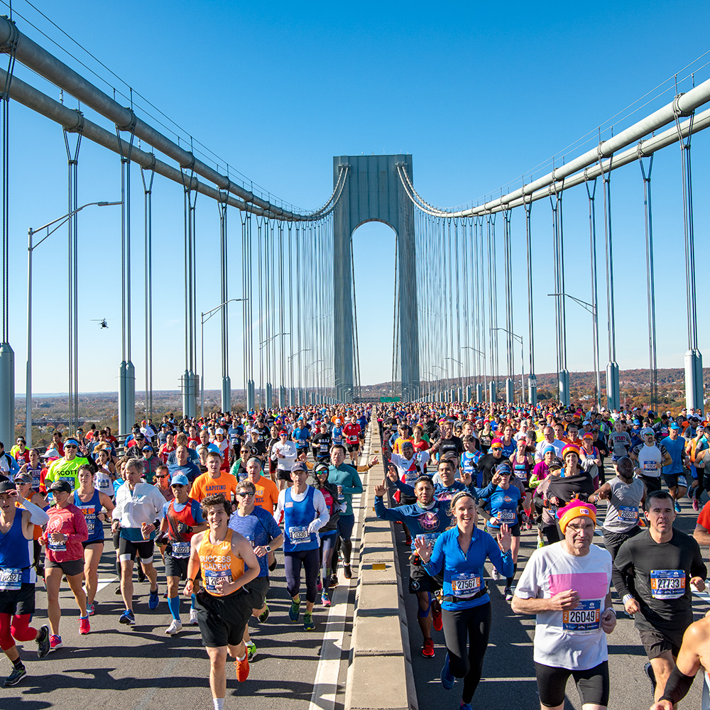
What is a Hackathon?
A Hackathon is a Hacking Marathon.
The goal is to build a complete software project
Teams and ideas can be established ahead of time, or during the event
All code for the project must be written during the event
Notes:
Now let's get into it. What is a hackathon? // Well, it's a HACKing MarATHON. // The goal is to build a complete software project within the allotted time. // Teams and ideas can be established ahead of time, OR during the event. // However, all code for the project must be written during the event. Also note that "Hacking" in this instance does not mean breaking into anything - it's all about building. ///

Slide 7

Fresh Code Rule
At most hackathons (including ours), no part of your project may have been created before the start of the hackathon. Code must be “fresh”
Fresh code ≠ looking up code
Feel free to reference previous projects
You’re more than welcome to look up examples
Google is a great resource, used by professional developers every day! Feel free to look up things you may not know
Notes:
So here's what you need to know to start building. The "Fresh Code Rule" will be in effect for the event: // basically, it means you can't come in with code already written. // This does NOT mean, however, that you can't look up code that already exists! In fact, we encourage you to find examples online, or use previous projects for reference. // Google is a great way to do this, and even professional developers use it every day. ///

Slide 8
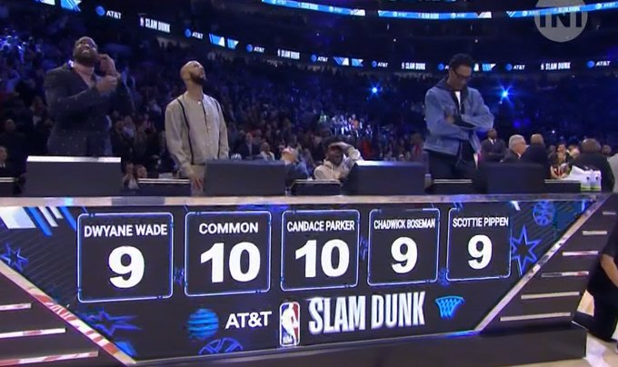
The Judgment Process
The judges know you only had 48 hours to work
Remember that the pitch sells the product
Materials
Enthusiasm
Practice!
Notes:
Once you've built your project, the judging process comes next. // Judges know you didn't have long to complete these projects, and they definitely take that into account when reviewing what you've built. // One thing to keep in mind is that sometimes, the pitch is just important as the product! // Create good presentation materials, // make it fun, show your enthusiasm, // and record yourself practicing and watch it back to improve. // You can also use mentors and other teams as practice dummies - they're sure to give you some great feedback! ///

Slide 9
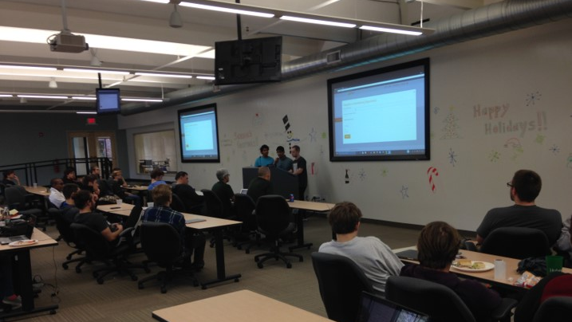
Final Round: In Front of an Audience
To win, you’ll need to be comfortable on stage
Attend the Presentations Workshop for help
Notes:
When it comes time for the final round of presentations, you'll be showing off what you built in front of the judges and an audience! ///

Slide 10
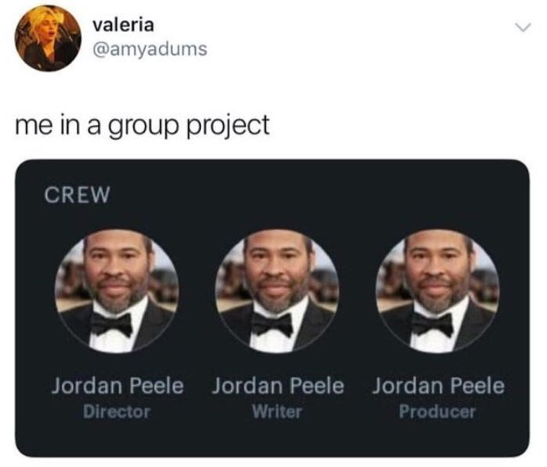
Project Time
Working as a Team
Notes:
But before you get to that point, let's talk a bit more about project time. Remember, you'll be working in a group here, and you probably don't want to end up like Jordan Peele and take on every single responsibility. Teamwork is important! ///

Slide 11
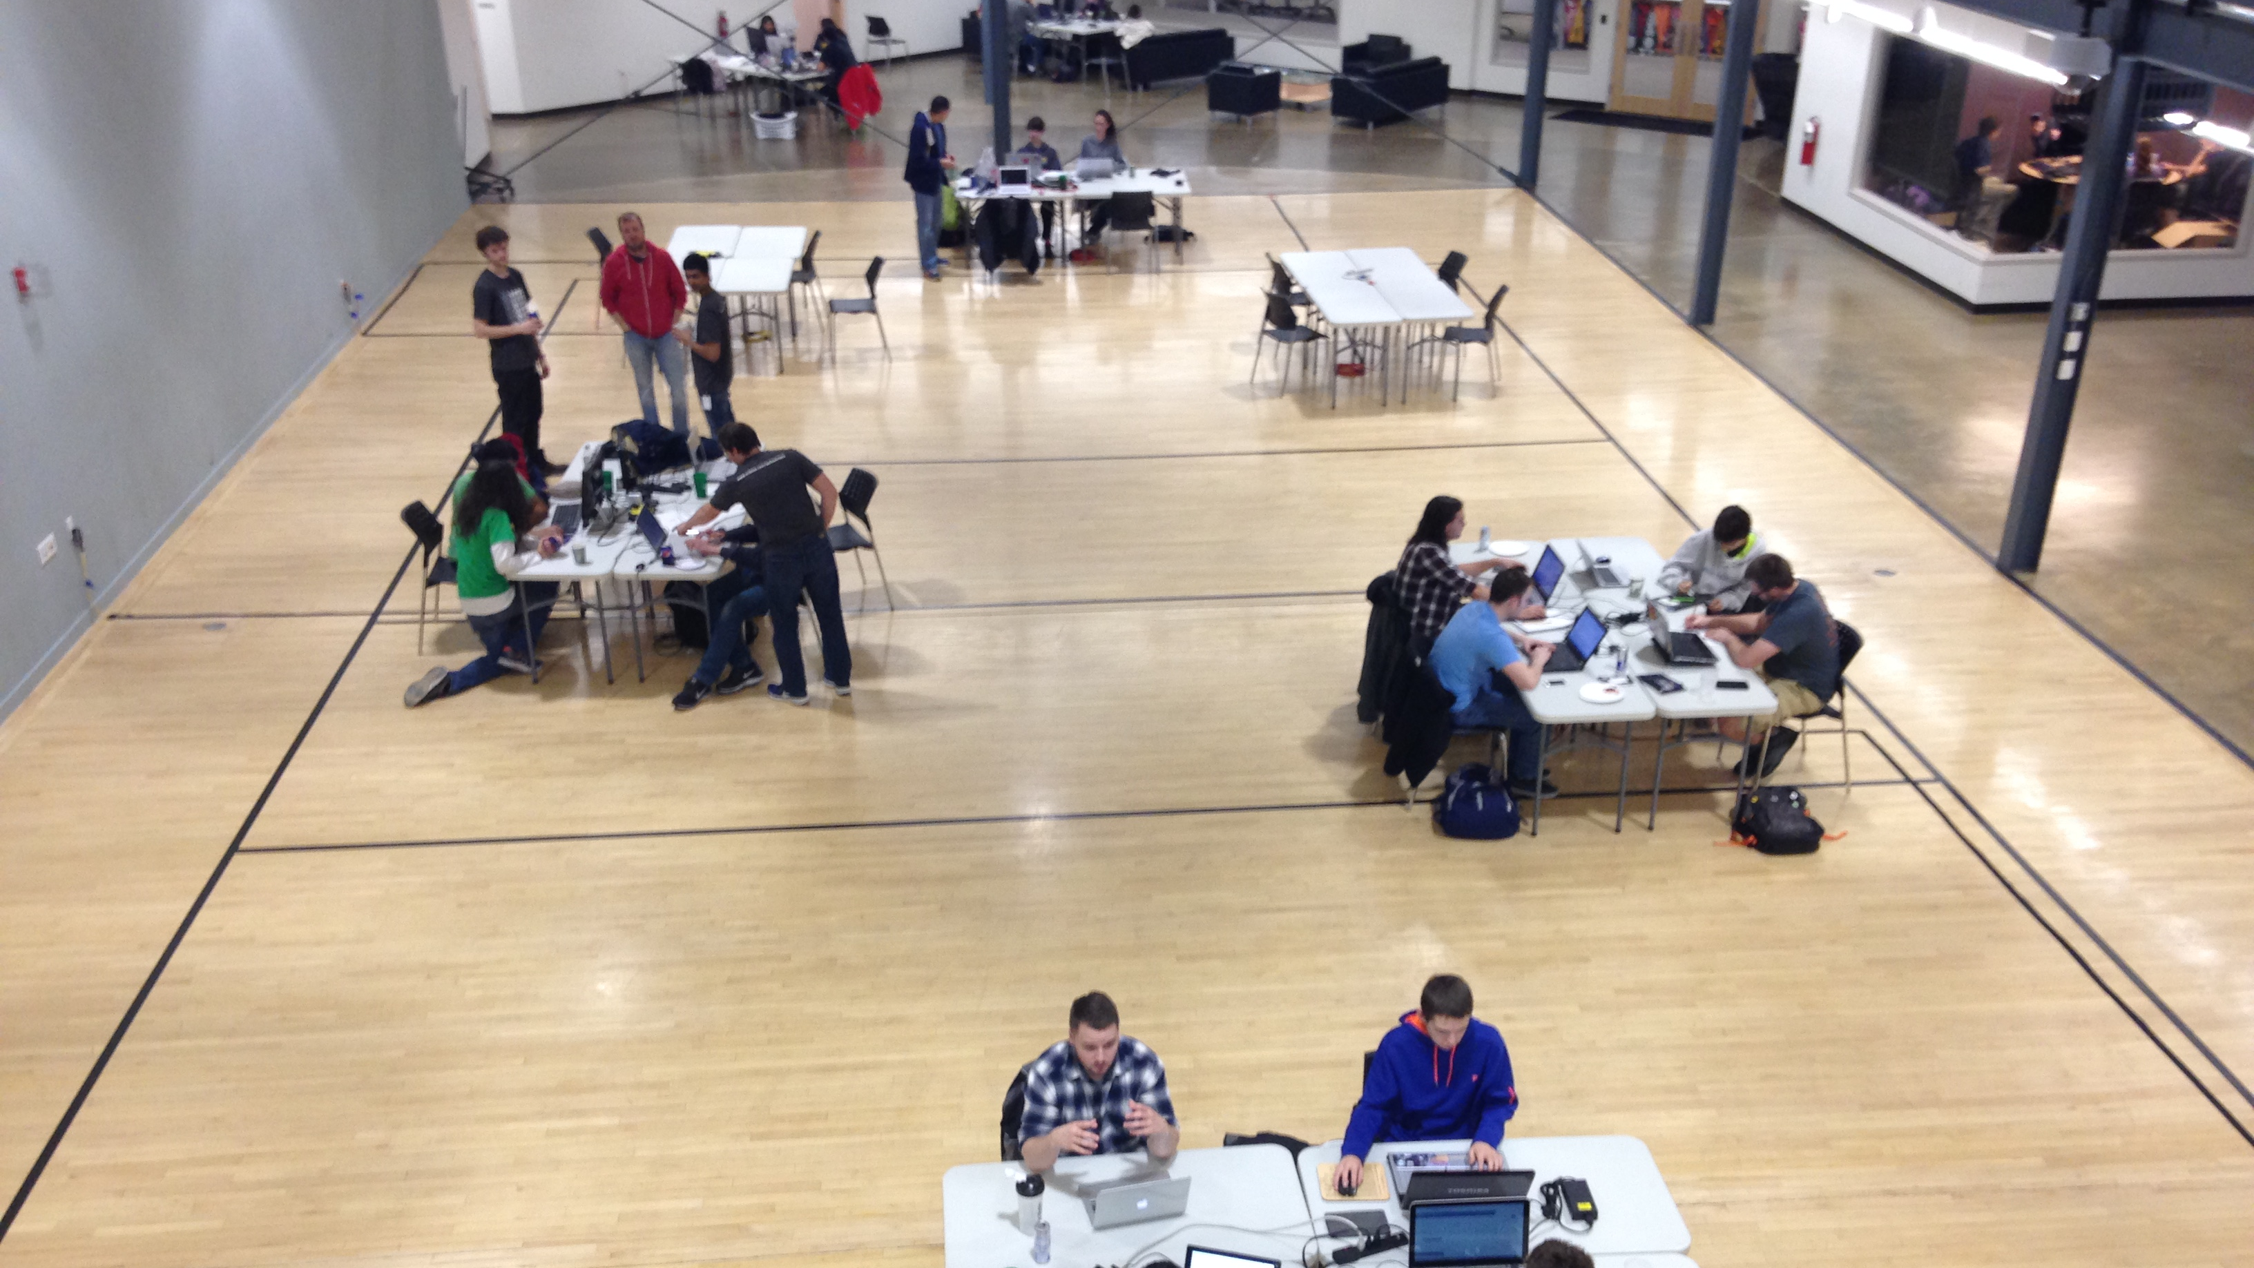
Workstations
Group up with your team (online or in-person)
Set up your area for success
Notes:
You can come with a team, or find one when you arrive. Once you're grouped up, you can grab a workstation and start developing! ///

Slide 12
Deciding on a Project
Try to think of a problem that exists, and find a software solution
Explore a new technology by building something with it
Think of something that you want to exist, and bring it to life!
Ideas
Website/Web App
A.I.
Blockchain
Social Media App
VR / AR
Game
Notes:
A very important first step here is to figure out what project you actually want to build. // Some ideas are to try to think of a problem that exists, and fix it... // Explore a new technology by building something with it... // or think of anything that you want to make, and bring it to life! // Some basic ideas include // building a website, a social media app, a game, or trying to work with VR, AR, blockchain, or AI to do something really innovative. It's worth spending a decent chunk of time brainstorming on ideas before diving in - it will make a big difference in the outcome! ///

Slide 13
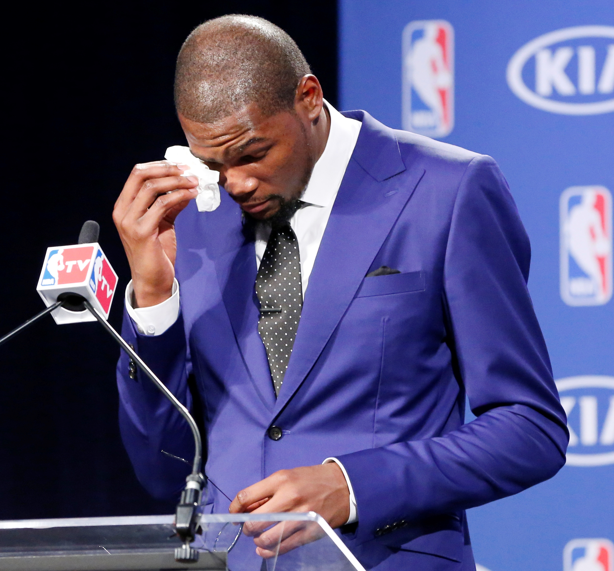
Focusing on an M.V.P.
Minimum Viable Product
A version of a product with just enough features to be usable
Figure out the highest priority features, and work on those
Create something demo-able, even if it’s not releasable
Focus on what’s interesting
Notes:
Once you're ready to start planning out the features of your project, you'll want to focus on an M.V.P. In this case, that does not stand for most valuable player like Kevin Durant here. In the software world, MVP stands for Minimum Viable Product. // It's the most basic version of a product that does just enough to be useful. // You'll want to figure out the highest priority features, and work on those. // Given the short time frame, it makes sense to create something that is DEMO-ABLE, even if you wouldn't actually release it for people to use. // You'll also want to focus on what's INTERESTING -- don't worry about the insignificant details, work on what YOU want to work on! ///

Slide 14
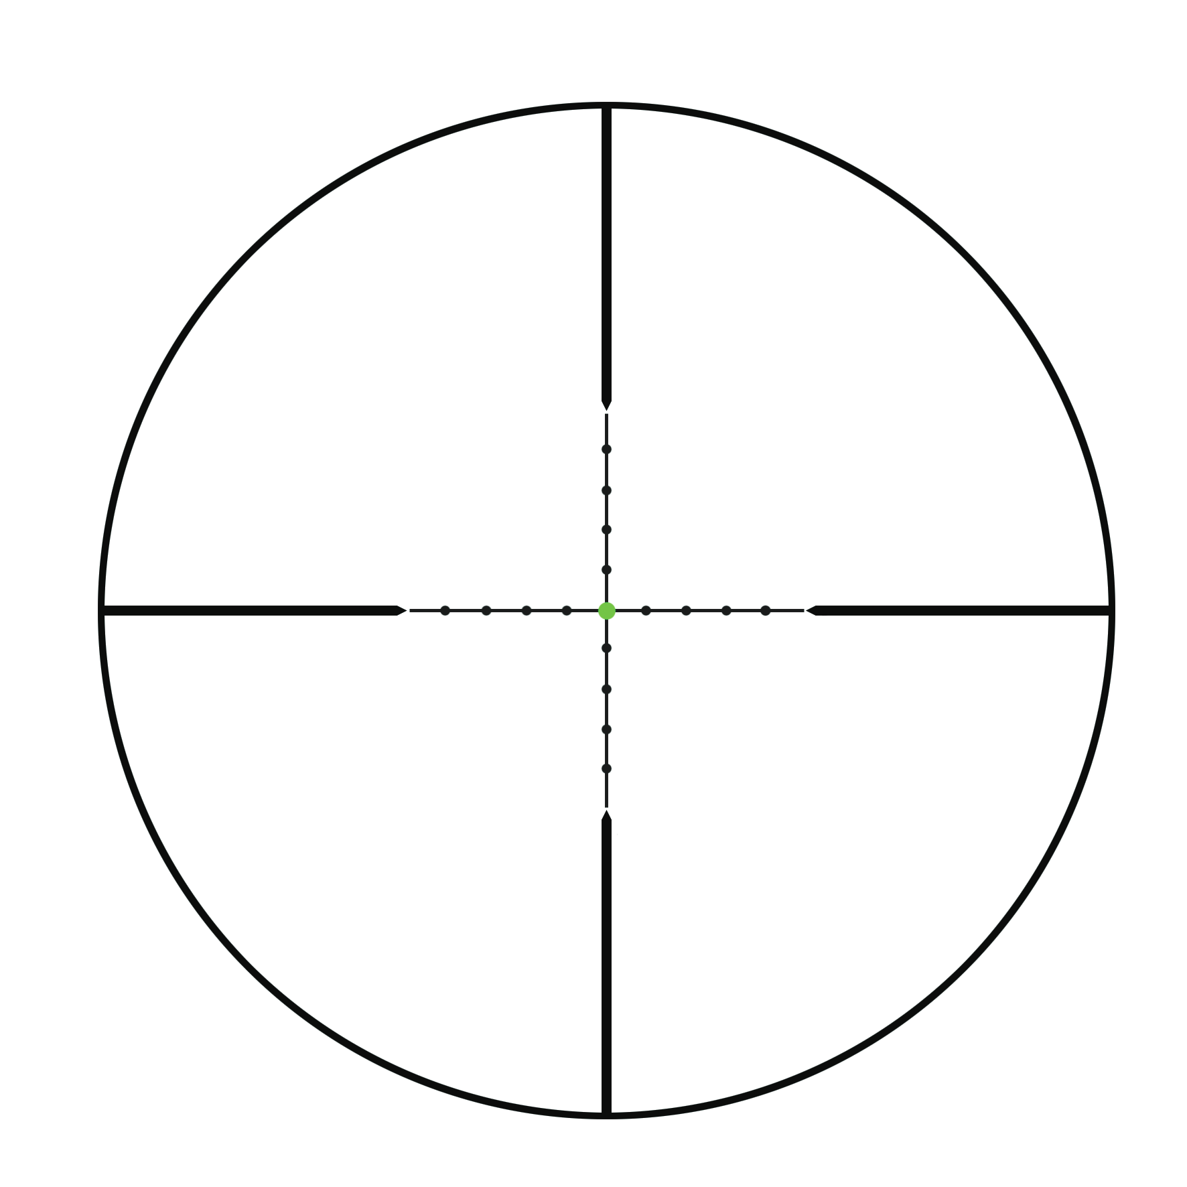









Project Scope
Scope – the amount of work needed to complete a project
Make sure your aspirations are not too ambitious – decide which features are doable
Speed things up by using existing libraries when possible
What can you finish before the deadline?
Notes:
Speaking of figuring out what to work on, you'll want to make sure you have an appropriate project scope. Try to figure out what you can finish before the deadline. // It may be difficult, but it's worth taking the time to narrow down your ideas to focus on the right project. // When building a product like this, SCOPE is the amount of work needed to complete a project. // You'll want to make sure your aspirations are not too ambitious - whatever you decide to make should be buildable within the weekend. // We encourage you to speed things up by using existing libraries whenever possible! ///

Slide 15

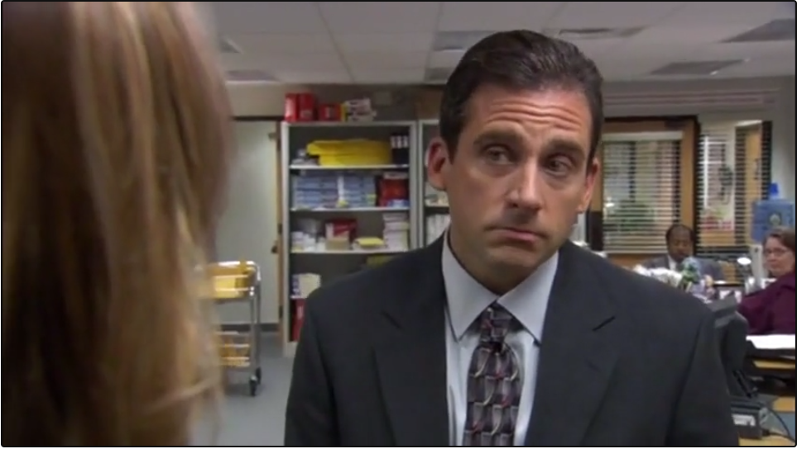
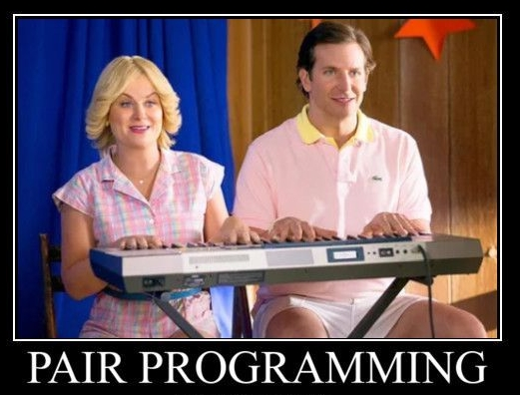
Time to Work: Collaborate!
Keep Talking
Delegate Tasks
Figure out who can do what
Switch Roles Frequently
Be supportive of each other!
Driver & Observer
Notes:
Now, once you've come up with an MVP, with an appropriately narrow scope, it's time to work. It will be very important for you to be able to collaborate with your team members! // Try to keep up the chatter on Discord or whatever communication channel you choose to use - make sure everyone is on the same page at all times. // You will also want to play Manager a little bit, just like Michael Scott, and _delegate_ tasks. Figure out who can work on what part of the project, and make sure everybody is able to contribute. // One really helpful technique you can try is Pair Programming (just like Amy Poehler and Bradley Cooper but on a computer instead of a piano). // Split two team members up into a driver and an observer - the driver is at the computer typing code, and the observer watches what they're doing, and ask questions or makes comments as needed. // The key is for the two team members to swap roles on a regular basis, so each team member has a chance to be in control. If you're really bold, you can also try MOB programming, where everyone on the team sits around ONE computer and codes everything as one big group. // No matter what you decide to do, the most important thing is to be supportive of each other! As they say in High School Musical, we're all in this together. Make it fun! ///

Slide 16
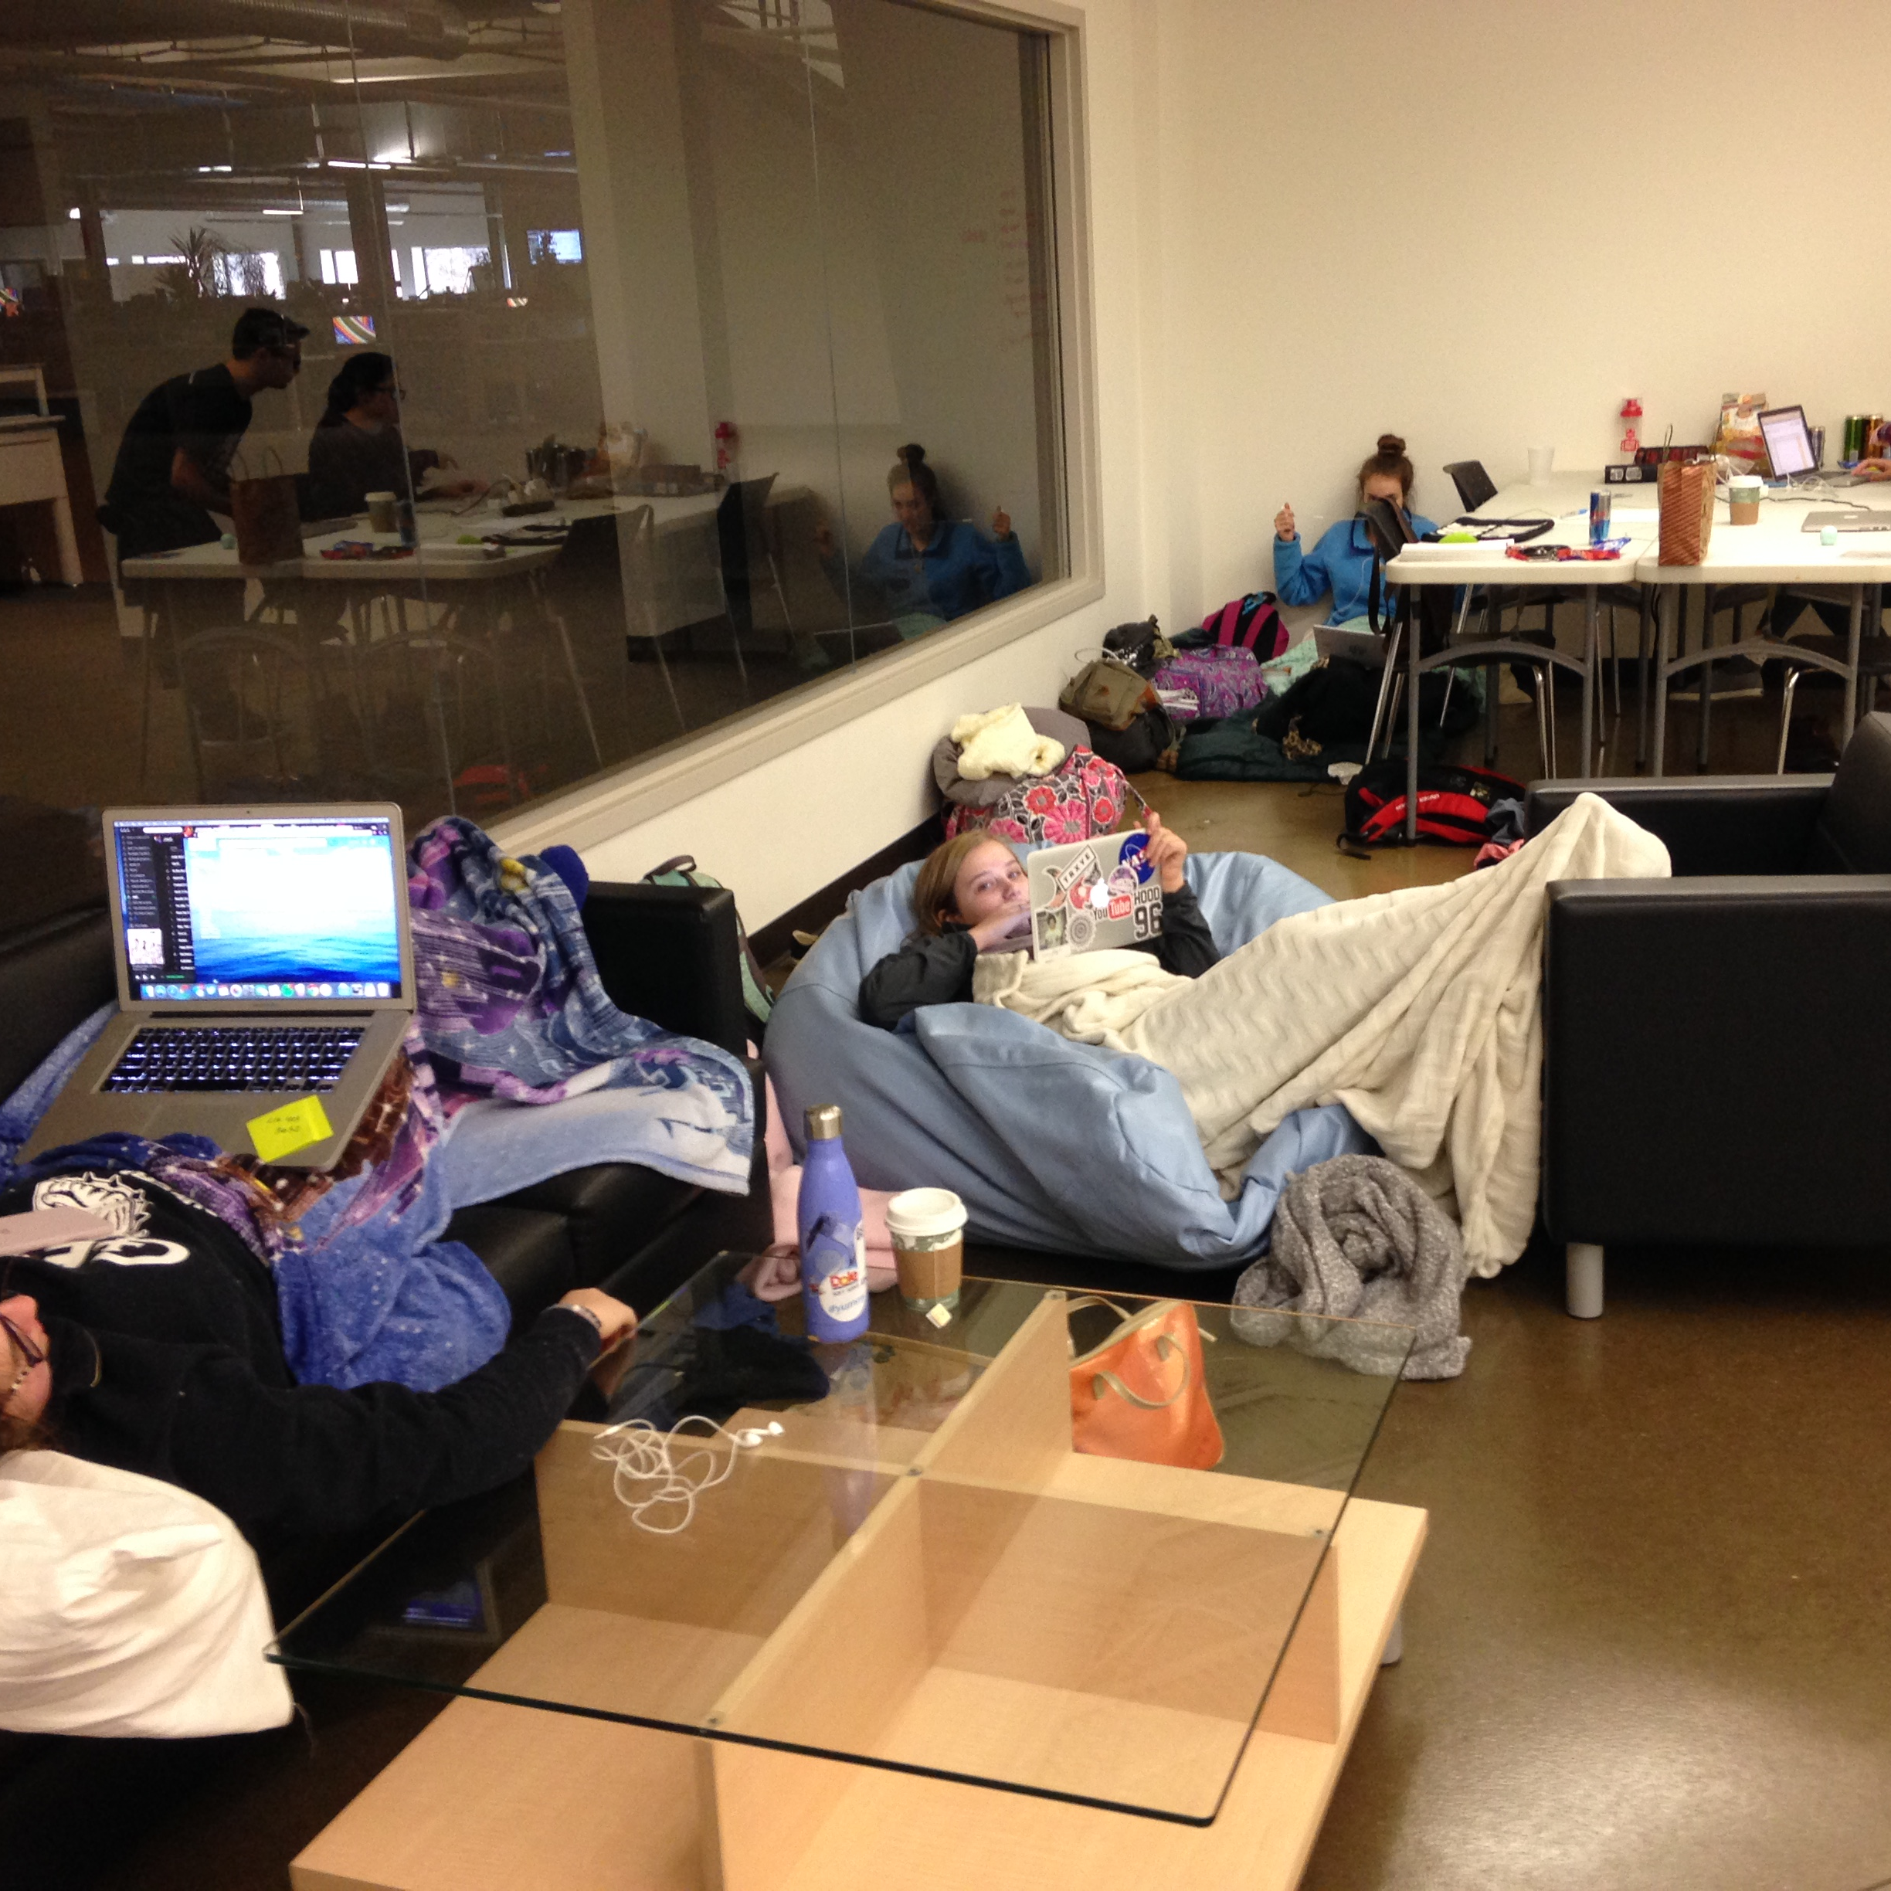
take time to relax
Notes:
One of the best parts of the event will be simply hanging out with your team, relaxing, and working together. ///

Slide 17
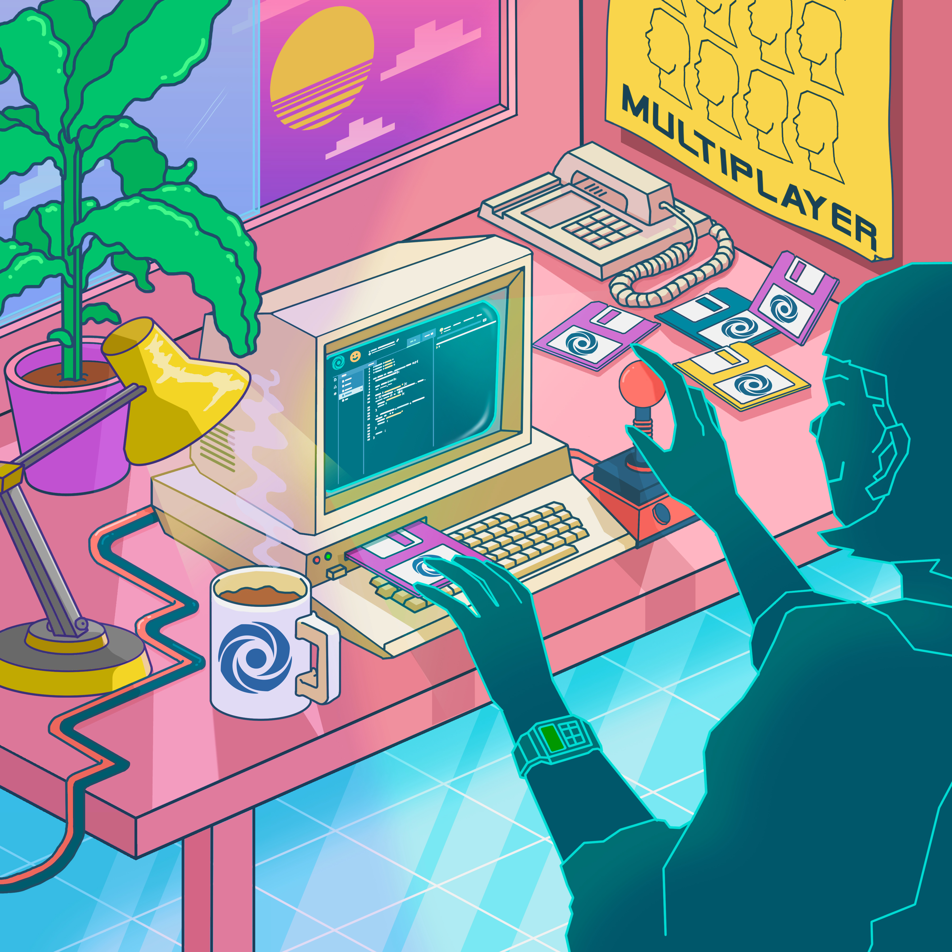

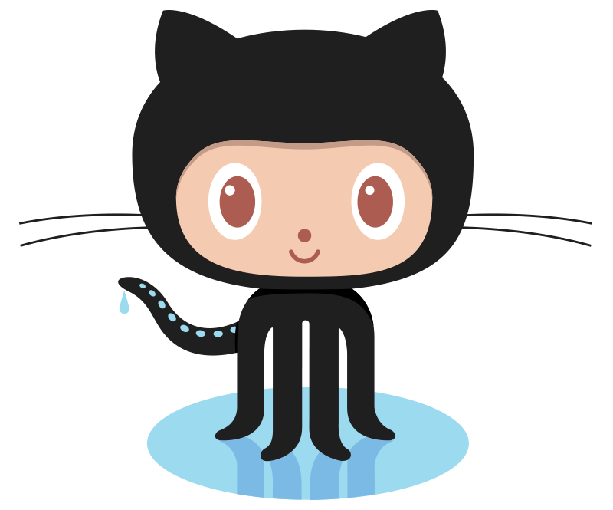
Collaboration Tools
Replit.com Multiplayer
Live chat
Live editing
Easy to connect
Like Google Docs for code
VS Live Share
Great IDE features
Use Visual Studio or VS Code
More complex
GitHub – Join the Workshop Session!
Notes:
Now let's get into some of the ways you can actually do that! // One great tool is replit.com, especially its Multiplayer feature. It allows for live chat, live editing, and easy connections. It's kind of like Google Docs but for coding and building projects! Replit also makes deploying your projects super super easy, so it's probably the simplest option. // Another option is Visual Studio Live share. With this, you'll get the fantastic IDE features of Visual Studio or VS Code, and you can work together from anywhere! It is a little more complex than replit, but it may be the way to go if you want to dive into a more serious development environment. // We also encourage you to utilize GitHub for version control, for many reasons. If you'd like to learn more about it, attend the Workshop Session that will take place during the event! ///

Slide 18
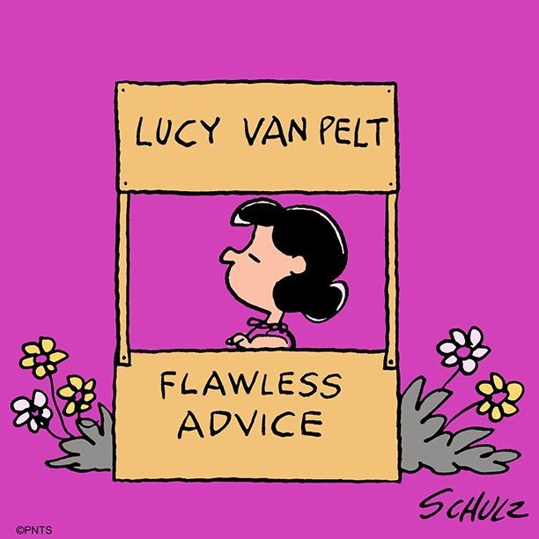
General Advice
Notes:
Now, let's go over some general advice. Or, "Flawless" advice as Lucy Van Pelt might say. ///

Slide 19


How To Survive Coding For 48 Hours
You can’t make a good product if you’re not in good shape…
Notes:
You're going to be coding for a long long time... but you cannot make a good product if you are not in good shape. Here are some helpful ways for you to survive the weekend. ///

Slide 20
How To Survive Coding For 48 Hours
Throughout the weekend, stay clean! Wash up, brush your teeth, change your clothes. If you’re in person, we have showers!
Try to eat something other than candy (and drink more than just coffee and energy drinks). If you’re in person, we will feed you!
Get outside, go for a walk, step away from the screen every once in a while. We will offer activities throughout the event if you want to take a break and have some fun!
Try to sleep – even short naps can be very helpful. If you’re in person, we will have quiet areas available!
Notes:
Be sure to stay clean! Hygeine is very important. If you're here in person, we have showers you can use. // Make sure to watch what you eat. It's easy to stick to the snacks, but try to consume healthy, wholesome things too. If you're here in person, we'll serve you some great food and beverages. // Please get outside if you can, go for a walk, get away from your screen every once in a while. We will have some fun activities throughout the event for you to take advantage of during breaks - be on the lookout for those! // Lastly, and this one may be tough, but we do encourage you to try and get some sleep. Even short naps can go a long way. If you're here in person, there will be quiet areas available where you can get some rest. ///

Slide 21
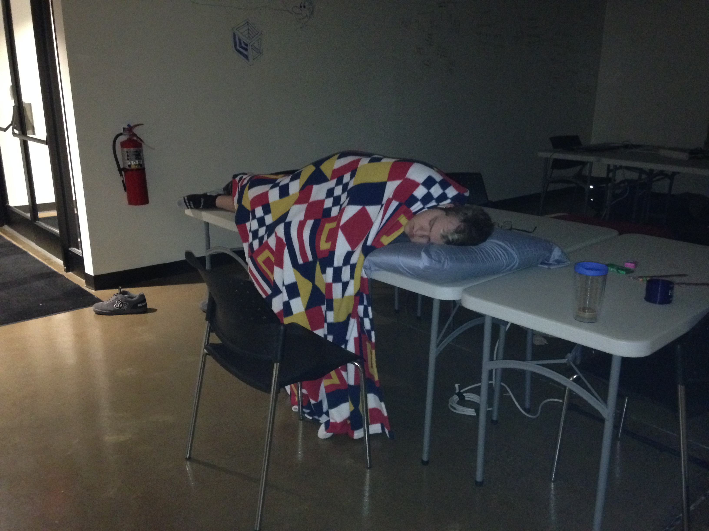
Or you can sleep on a table
Notes:
Or, you can sleep on a table. ///

Slide 22
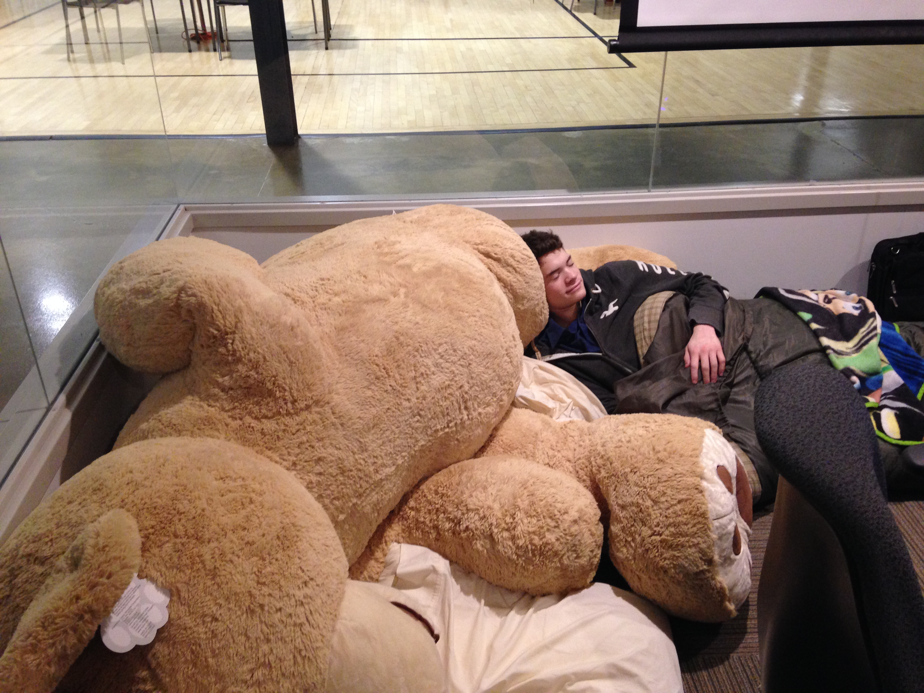
Or a
giant teddy bear
Notes:
Or on a giant teddy bear. ///

Slide 23




No Experience? No Problem!
Hackathons can be a fantastic learning experience!
🚀 🚀 🚀
Notes:
Now, you may be completely new to this... and that's great! Hackathons are a great way to learn a ton. // Check out code dot org if you want to learn some basics in drag and drop languages, // w3 schools dot com if you want to start building a website, // youtube for learning pretty much anything at all, // or code cademy that has tutorials for a variety of languages. Each of these resources has free options available. // Also, make sure to follow our explorer track! you can learn more at tinyurl.com/hackhyland2023!

Slide 24
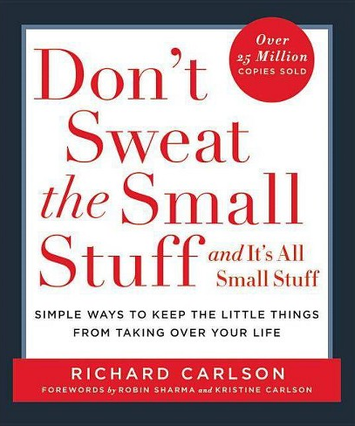
Don’t Sweat the Small Stuff
You underestimated how much time you had, you used a language you never used before, you had a bunch of technical difficulties…
Hackathons are more than a competition.
Networking and making friends
Practicing your skills
Learning something new
Simply having fun
As long as you enjoyed your time and became a better developer, you won!
Notes:
Another piece of advice - don't sweat the small stuff. // Maybe you underestimated the time you had, or you used a difficult new languages, or ran into a bunch of technical troubles... // all of that is totally fine and normal! don't worry about it! // At the end of the day, a hackathon is SO MUCH MORE than a competition. // If you made some friends, practiced some skills, learned something new, and had fun, you succeeded! // As long as you enjoyed your time and became a better developer, you won. That's all there is to it. ///

Slide 25
Important Takeaways
Do
Don’t
Practice self-care: sleep and keep up on hygiene
Plan & scope your project
Use existing libraries
Focus on learning
Have fun!
Burn yourself out ONLY working on your project
Spend your whole night debugging one line
Work on only boring parts of the project (e.g., login)
Take it too seriously
Notes:
Now let's go over some important takeaways. We'll start with the don'ts. // Don't burn yourself out ONLY working on your project. // Don't spend your entire night debugging one line. // Don't work on only the boring parts of your project, like a log in system. If you love authentication that's fine; just try to focus on what's fun for you! // And lastly, try not to take it too seriously. Now onto the Dooze. // Practice self-care! Sleep and keep up on hygiene. // Take the time to plan your project, and make sure the scope makes sense BEFORE you start coding. // Don't be afraid to use existing libraries if necessary. That's how it works in the real world! // Focus on learning. // and above all else, HAVE FUN! ///

Slide 26


Inspiration
This hackathon could be the beginning of something great…
A project that didn’t even win at TechCrunch Disrupt
Became a real product and company
Sold to Skype for $85 million
Hacking for Charity
20 projects that help non-profit organizations
A different kind of impact
Notes:
Now, if you still aren't inspired, here are some quick stories. This hackathon could be the beginning of something great. // GroupMe is an example of a product that started as a hackathon idea. It was a project that DIDN'T EVEN WIN at techcrunch disrupt, // but the folks who built it liked it, so they turned it into a fully-fledged product and company. They then went on to sell it to Skype for EIGHTY-FIVE MILLION DOLLARS! That could be you. You could have eighty-five million dollars because of this hackathon. // Another example is GiveCamp that took place in Cleveland Ohio. // The idea with this hackathon was to hack for charity. // 20 projects were created, all designed to help non-profit organizations. // These products are still helping those groups to this day, and having a real impact on the world! Remember, the theme for the hackathon is Coding For Good, so whatever you make could go on to make great things happen. ///

Slide 27
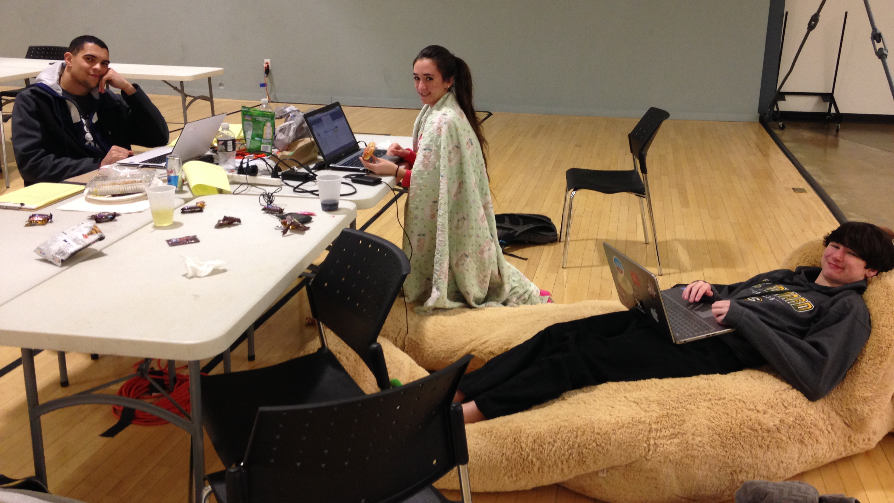
You could wind up with an internship!*
*indirectly
Notes:
And, if that's not enough, you could go on to work at Hyland someday, like some of our former hackathon attendees. The sky's the limit! ///

Slide 28

If you only do what you can do, you will never be more than you are now.
Master Shifu
Kung Fu Panda 3

Slide 29




Thank you
tinyurl.com/hackhyland2023

